Slide 1
On RTG Design
Alexander Hoppe and Taylor Sheneman

Slide 2
Our System

Slide 3
How little plutonium can we use for a given power and mission length?

Slide 4
Our Model

Slide 5
Our Results
Power Threshold = 100W

Slide 6
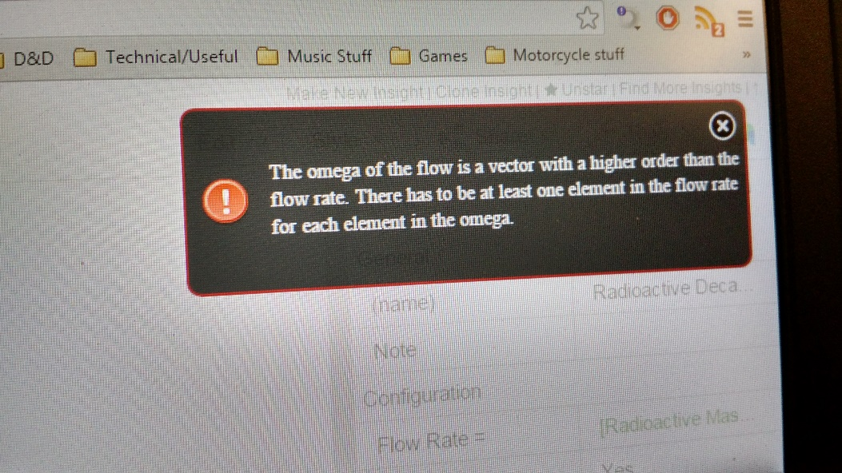
Our Failures
Silliness
MATLAB: “No params defined. Perhaps Java isn’t running?”
Insight Maker: “Are you dividing by zero?”

Slide 7
Our Design Recommendation

Slide 8
LOL JK MORE FAILURES

